Slide 1
Separation in Industries

Slide 2
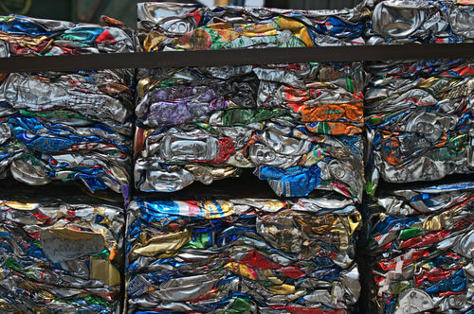
By the end of this lesson you should be able to:
Explain how different metals are extracted and separated.
Explain how a cyclonic separator works.

Slide 3
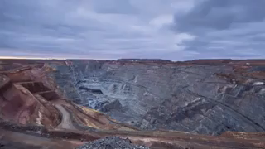
Almost all of the metal that you use daily has been removed from the ground by mining.
We often have to dig deep into the ground to find precious metals like gold or silver.
Most metals are not in the ground ready to be used. Metals like copper and iron are found in mixtures called metal ores.

Slide 4
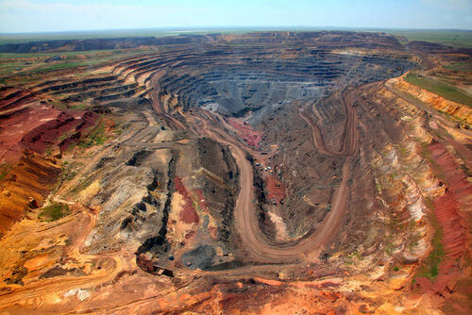
A metal ore is a mixture of two or more different types of particle, at least one of which is a metal.
The major component of the ore will be a particular metal.
The metal ore is mined specifically to obtain that metal. Iron ore is mined to obtain iron, aluminium ore for aluminium, and so on.

Slide 5
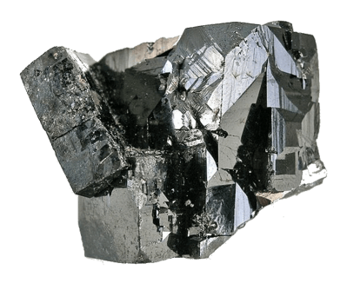
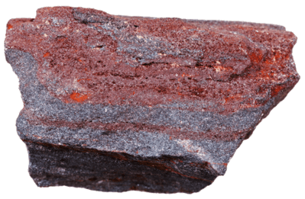
Iron is usually mined from ores called iron oxides, the most common of which are magnetite and haematite.
Ores are mixtures of metal particles and other particles, like oxygen or silicon. Both ores mentioned above are mixtures of iron and oxygen.
Magnetite is only about 72% iron, so miners need a way to remove the other particles and obtain pure iron.

Slide 6
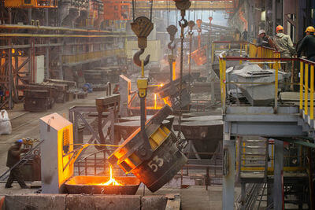
Many ores contain or are contained in other rocks that are considered useless - these rocks are called gangue (pronounced "gang").
Iron is usually separated from gangue and oxygen by smelting it.
This involves mixing iron ore powder and charcoal in a furnace - by burning this mixture, we get pure iron and carbon dioxide.

Slide 7
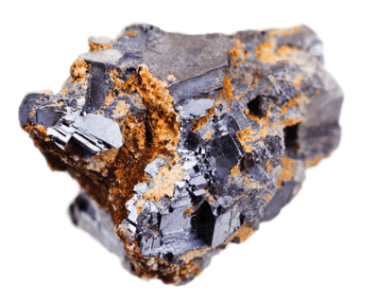
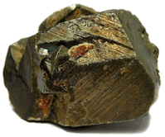
Copper is another important metal - we use it to make electrical wires, coins and pipes, among other things.
It can occur as pure copper, but is also found in copper ores such as chalcopyrite and chalcocite.
Copper ores often contain a lot of gangue, which is ore that is worthless, so a separation process is needed to remove this from the ore first.

Slide 8
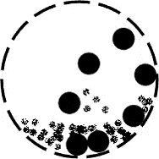
Copper undergoes a two-step process for separation.
First, the copper ore and gangue are crushed into a fine powder using a ball mill.
A ball mill is a long barrel full of heavy steel balls. The barrel is rotated and the balls roll around, crushing everything else inside the barrel.

Slide 9
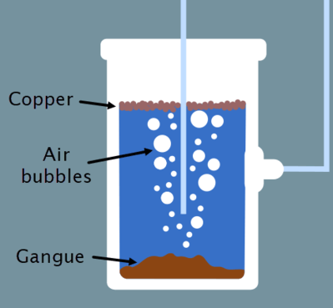
Next, the copper and gangue powder is added to a solution of water and chemicals and stirred, creating a suspension.
The suspension has air bubbles blown through it, which carries the copper ore to the surface of the water. Over time, gravity sinks the gangue to the bottom of the water.
Copper ore can then be skimmed off the top of the water (decanted) and treated to extract pure copper.
This process is called "Froth Floatation".

Slide 10
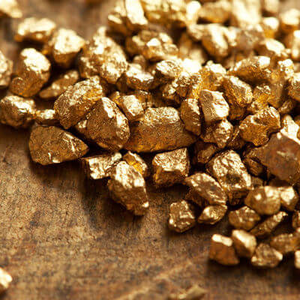
Gold, meanwhile, is separated in a different way.
It occurs naturally as pure gold, but it usually mixed with lots of rocks.
Gold and the rocky gangue are put through a ball mill to make a powder. The powder is mixed with water and spun. Gravity separation happens as the mixture is spun, separating the gold and rocks. This happens because gold is much heavier than the rocks that contain it, so it sinks to the bottom of the water. This happens in a device called a cyclonic separator, but more on that later.

Slide 11
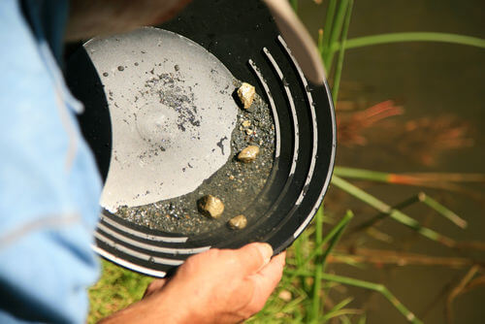
Gold panning uses a similar process - water, rocks and gold are all mixed inside a pan.
By shaking the pan, gold is moved to the bottom of the pan, and the rock and water can be slowly shaken off the top of the pan, leaving behind small pieces of gold.

Slide 12
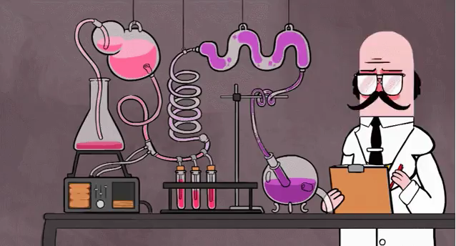
Sometimes, one separation technique on its own is not enough to properly separate a suspension.
We usually just do one technique after another, but this can take some time. Another option is to develop new methods that combine two or more separation techniques.

Slide 13
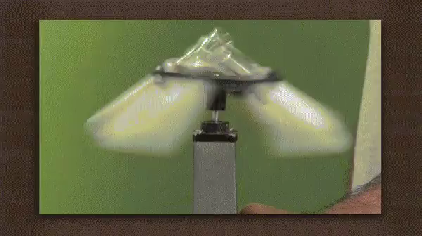
Cyclonic separation is one such technique that is being used more and more in industry.
It uses rapid spinning and gravity to separate solids from a liquid or a gas.
It is a combination of gravity separation and centrifuging.

Slide 14
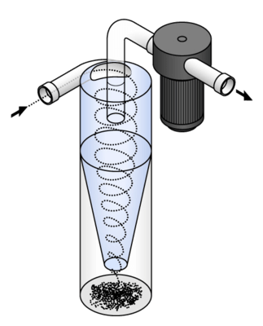
We can use cyclonic separation to clean water of solid particles.
A machine called a cyclonic separator is used. This resembles a cone or funnel and water is fed into it. The main funnel part is called the cyclone chamber. Water is pushed into the cyclone chamber at a high speed, and it spins around in a spiral from top to bottom - much like a cyclone.

Slide 15
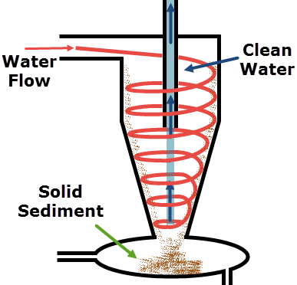
The spiral of water is similar to how water travels down a sink or toilet bowl.
It is represented by the red lines in the below picture.
The heavy solid particles are thrown onto the wall of the chamber, while the lighter water particles are not - much like a centrifuge.
Gravity causes the solids to slide down the side of the chamber.

Slide 16
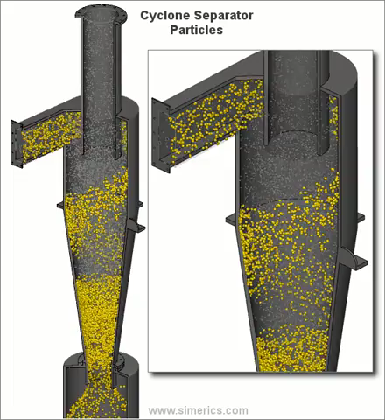
The GIF below shows the movement of particles in a cyclonic separator.
The solid particles, shown in yellow, are collected at the bottom of the chamber, while the liquid/gas particles, shown in blue, are drawn through the pipe at the top.

Slide 17
Air can be cleaned of solids in this way too!
Smoke or sooty air is fed into a cyclone chamber, and the solids fall down the sides as the air is spun. Clean air rises from the bottom and is ejected through the top.
This is how some vacuum cleaners work! The fast-moving air sucks up dust from the floor and ejects it to the sides, where it falls down into the vacuum bag.

Slide 18
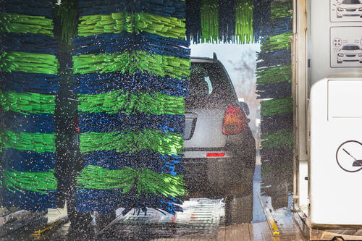
Cyclonic separation has many different applications and is being used more frequently in industry.
While its original use was for separating rocks for mining, it is now also used to clean air in factories, clean water for irrigation and is also used in vacuum cleaners.
It doesn't just separate solids! Oil and water mixtures can be successfully separated by cyclonic separators - car washes use this to clean oily water. In this case, water is the heavier substance and it collects at the bottom of the separator.

